Slide 1
Live Credit Card Transaction : Fraud Detection using PySpark
Group Number : 13
Team Members:
Alejandra Martinez Aleman
Abhilash Dattatray Patade
Mark Rodgers
Alen Roby Thomas
Rohan John Jose

Slide 2
Introduction :
Harnessing Big Data for Real-Time Security
In this project, we're diving into a massive set of credit card data—5.5 million records—to figure out who might stop using their credit cards, a phenomenon called churn.
We have collected our dataset from IBM Developer website.
Our goal is to create a smart model that predicts churn accurately. To get there, we start by cleaning up the data to make sure it's accurate and ready for analysis. Then, we dig deep into the data to understand trends and patterns using techniques like exploratory data analysis.
Next, we make sure all the data is on the same scale, so no one piece of information dominates the model unfairly. Finally, we use fancy math to build models that can tell us who might churn in the future. By doing this, we hope to help credit card companies keep their customers happy and minimize lost revenue.

Slide 3

Technologies Used
User Interface (NodeJs)
Dataproc (PySpark Cluster)
Cloud Function (ETL and Email Alert)
Kafka (PubSub)
MongoDB (NoSQL Database)
PowerBI (Visualization)

Slide 4
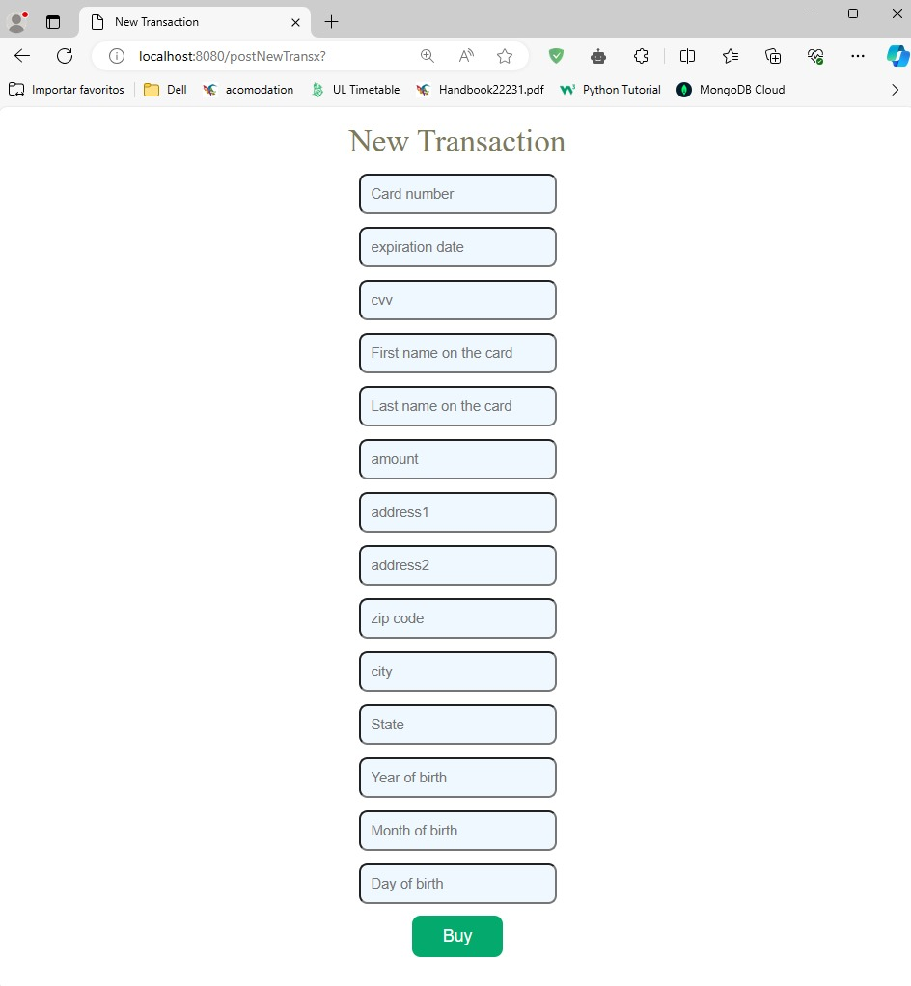
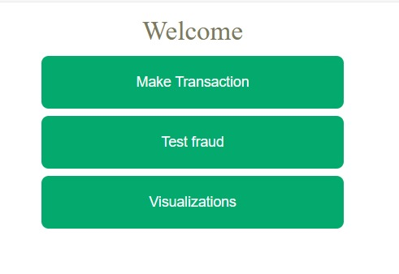
User Interface

Slide 5
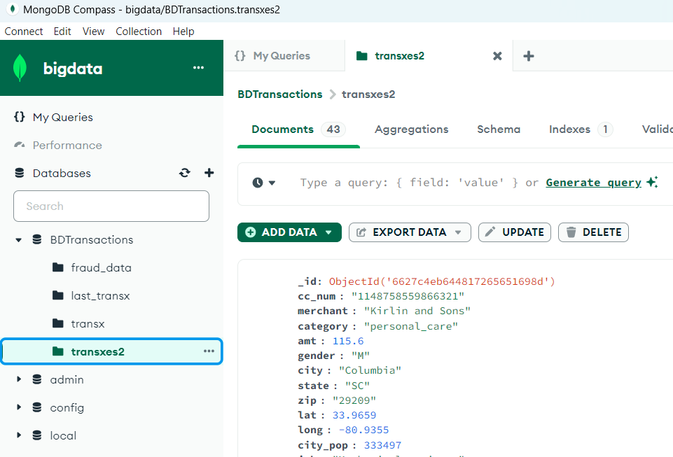
MongoDB Database
Nature of MongoDB:
NoSQL database, ideal for handling large volumes of unstructured data.
Document-oriented storage using JSON-like documents with dynamic schemas.
Role in Transaction Monitoring:
Critical for managing dynamic transaction data in real-time environments.
Supports complex queries and rapid data retrieval essential for fraud detection systems.

Slide 6
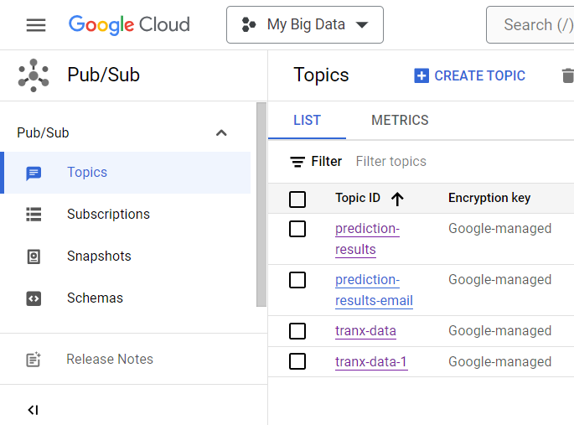
Kafka Pub/Sub Mechanism
Core Concept:
Kafka operates on a publish-subscribe model that facilitates real-time data streaming and messaging.
Producers publish messages to topics, and consumers subscribe to topics to receive messages.
We have used Kafka to communicate between different services in our architecture

Slide 7
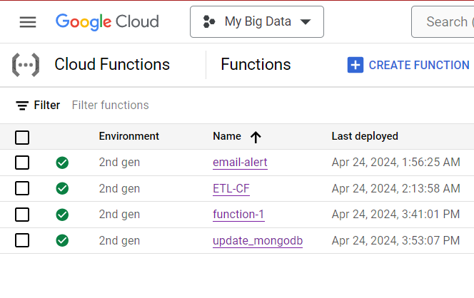
Cloud Functions - Enhancing Real-Time Response
Core Concept:
Cloud Functions are serverless, event-driven computing solutions that execute code in response to events.
Eliminates the need for server management, focusing solely on code execution.
We have utilized it for email alerting and ETL Process.

Slide 8
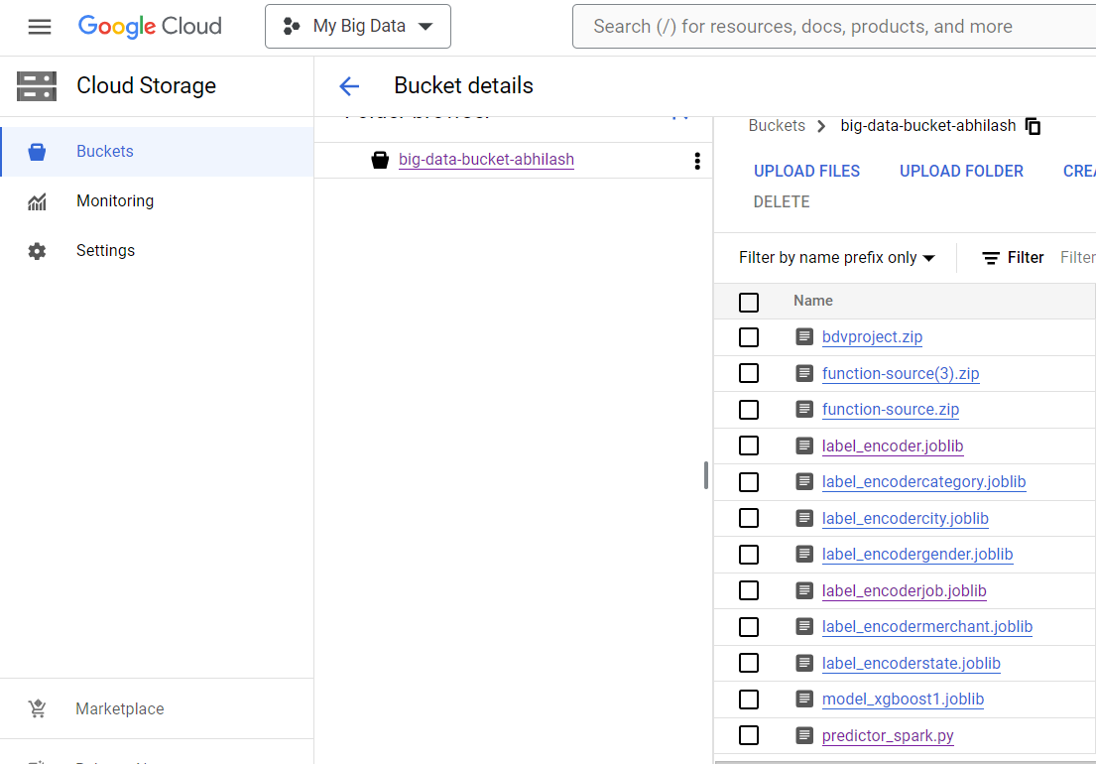
GCP Bucket
Core Concept:
GCP Buckets are used to store our data viz. Trained Model, Label Encoders and training data.

Slide 9
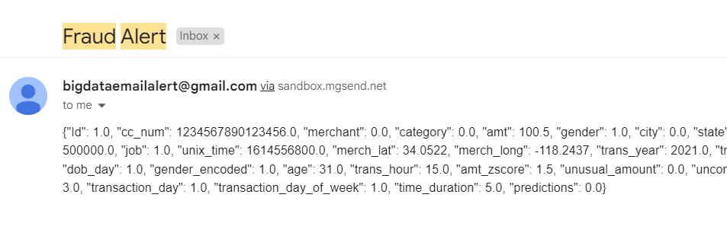
Email Alert

Slide 10
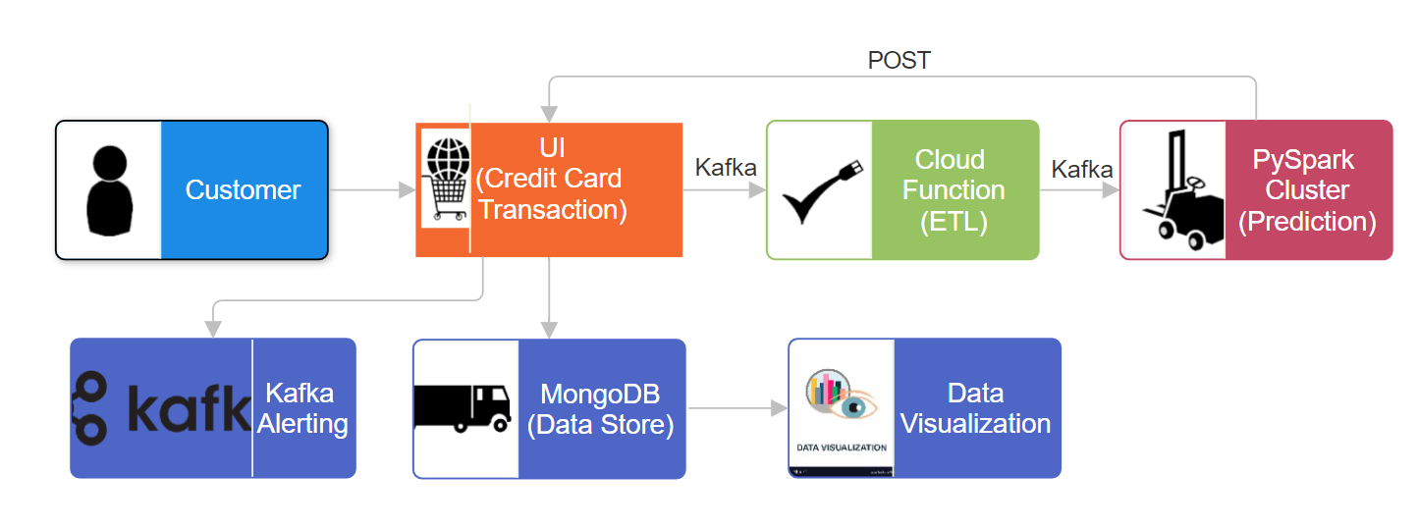
Architecture

Slide 11
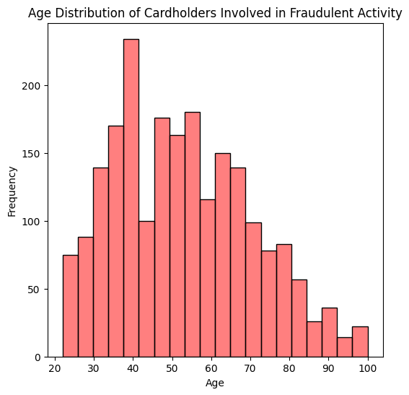
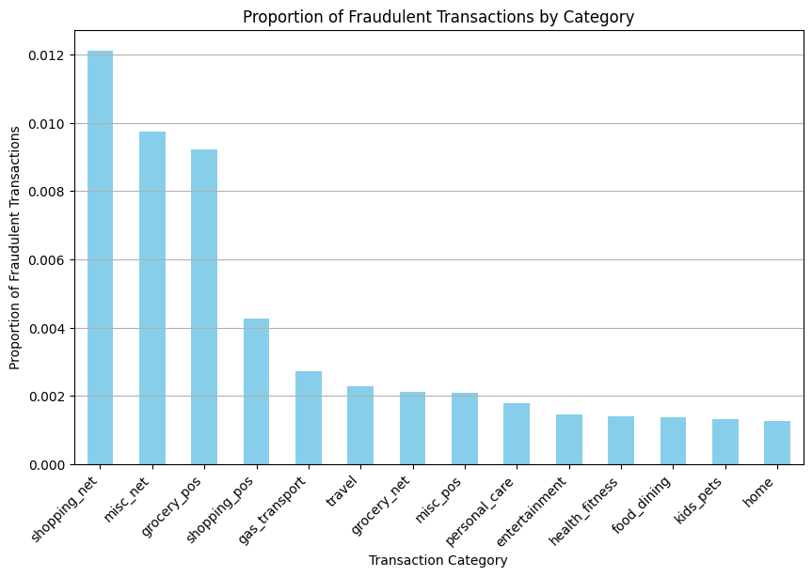
Understanding the Data

Slide 12
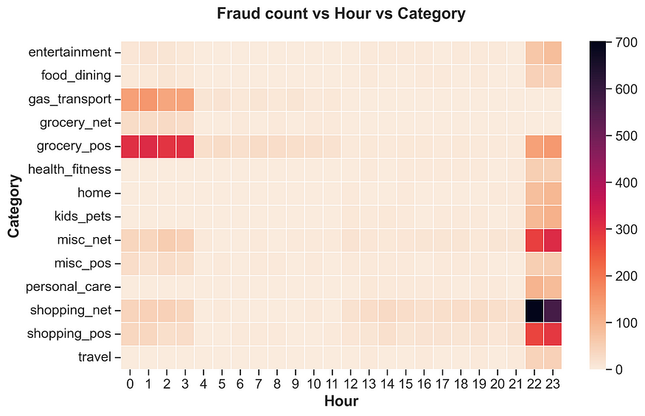
Understanding the Data

Slide 13
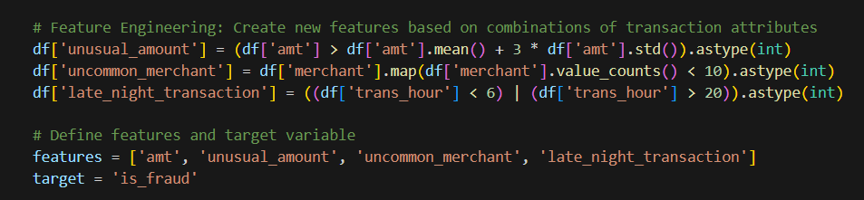
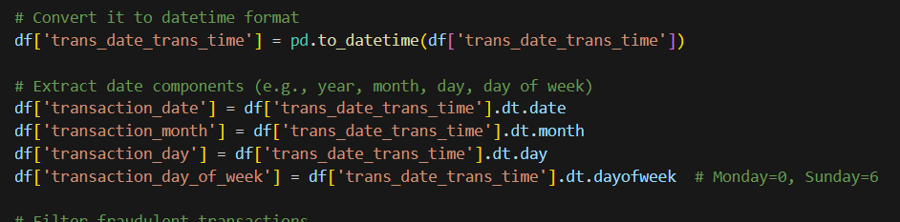
ETL

Slide 14
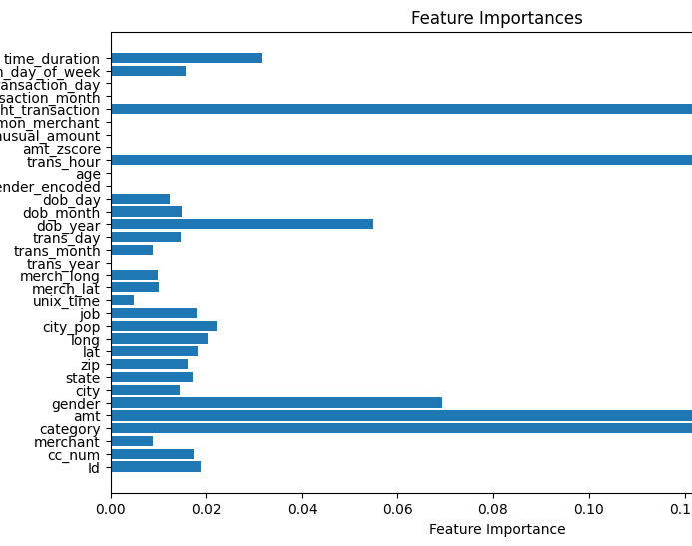
Feature Importance

Slide 15
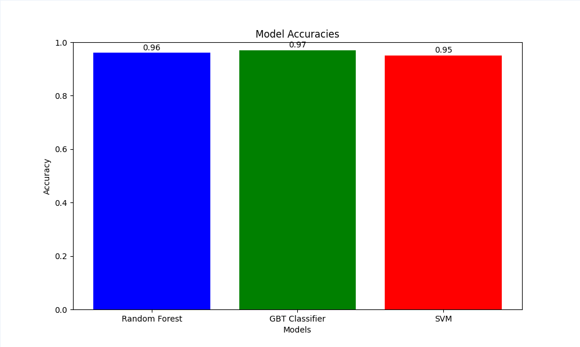
Model Performance

Slide 16

Overview of Historical Transaction Data
The historical transaction data provides valuable insights into fraudulent activities and patterns.
The dataset consists of comprehensive transaction records, with a total transaction amount of $38 Million.
The data is segmented into primary transactions, totaling $37 Million, and secondary transactions, totaling $1.13 Million
This dataset serves as the foundation for training machine learning algorithms to detect patterns indicative of fraud.

Slide 17
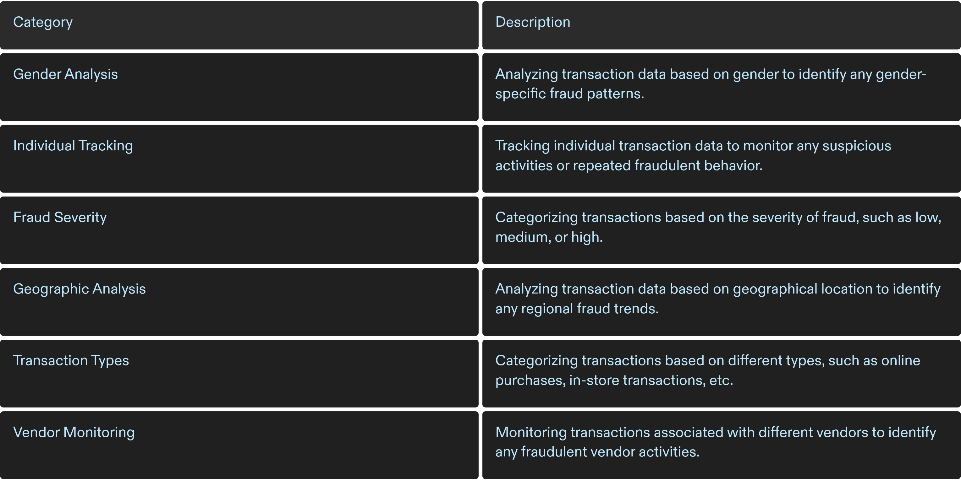
Allocation of Transaction Data Across Categories
In order to effectively analyze transaction data for fraud detection, the data has been organized into different categories. These categories provide insights into various aspects of the transactions and help identify fraud characteristics and patterns.
Categorizations

Slide 18
Utilization of Data in Fraud Detection
Data Preprocessing:
Ensure compatibility of transaction data with the algorithm's requirements.
Clean and transform data to improve accuracy and efficiency of fraud detection algorithms.
Transaction Pattern Analysis
Identify patterns and characteristics linked to fraudulent transactions.
Analyze transaction data to detect anomalies and potential fraud indicators.
Enhanced Algorithm Accuracy
Utilize machine learning techniques to improve the accuracy of fraud detection algorithms.
Train algorithms using historical transaction data to identify potential fraud with higher precision.
Mitigating Fraudulent Transaction Losses:
Implement measures to mitigate losses caused by fraudulent transactions.
Develop strategies to proactively prevent and respond to potential fraud attempts.
Notes:
Firstly, Data Preprocessing is where it all begins. We fine-tune our data to ensure it meshes well with our algorithms, scrubbing it clean and transforming it for maximum accuracy and efficiency in fraud detection.
Moving on to Enhanced Algorithm Accuracy, our use of sophisticated machine learning techniques is key. By training these algorithms with our historical data, we’re able to pinpoint fraud with ever-greater precision.
Next is Transaction Pattern Analysis. Here, we identify and analyze the patterns and characteristics that might flag a transaction as suspicious.
And finally, we tackle Mitigating Fraudulent Transaction Losses. Our proactive measures and strategies are all about staying one step ahead to prevent and minimize the impact of fraudulent activities.
In summary, our approach is methodical and data-driven, aiming to shield our system and our users from the risks of fraudulent transactions."

Slide 19


Slide 23

Enhancing Fraud Detection with Proven Accuracy
Proven Accuracy
Our system boasts a remarkable 97% accuracy rate in fraud detection.
Advanced Analytics
Our advanced analytics utilize high-precision algorithms to analyze transaction patterns and flag anomalies, ensuring accurate fraud detection.
Cost Efficiency
By effectively detecting and preventing fraud, our system reduces financial losses for financial institutions, delivering significant return on investment.
Customer Trust
By enhancing fraud detection and security measures, our system builds confidence in customers, leading to increased loyalty and satisfaction.
Notes:
Our system has proven its efficacy with an impressive 97% accuracy rate in detecting fraudulent transactions. This level of precision allows banks and other financial institutions to trust in our algorithm to significantly reduce the risk of fraud. By utilizing our advanced analytics, organizations can expect a sharp decrease in fraudulent losses and an increase in customer trust.

Slide 24
Your Partner in Security
Secure Transactions, Satisfied Customers
Strategic Partnership
Future-proof
Our system empowers banks and consumers with secure transactions, ensuring a safe digital transaction space and fostering a secure customer experience.
As your partner in security, our system acts as an extension of your security team, dedicated to fraud prevention.
Our system adapts to evolving fraud tactics, ensuring long-term protection in the ever-changing financial landscape.
Notes:
In an era where digital transactions are the norm, our system stands as a sentinel against fraud. It's not just a tool; it's your partner in ensuring transactional integrity. For banks and consumers alike, adopting our system means investing in a secure financial future, minimizing risks, and promoting a safe transaction environment for all users.

Slide 25
To conclude :
Achievements:
Successfully demonstrated the capability of PySpark to analyze and predict fraudulent transactions in real-time.
Integrated a robust system architecture using Kafka, MongoDB, and Cloud Functions to streamline data processing and alert mechanisms.
Performance Highlights:
Achieved high accuracy in fraud detection with real-time analytics, significantly reducing potential fraud risks.
Improved system responsiveness, allowing for immediate action on detected fraud through automated alerts.
Technological Integration:
Showcased effective use of big data technologies to manage and analyze vast amounts of transaction data dynamically.
Utilized the strengths of NoSQL databases and cloud-based computing to ensure scalability and flexibility of the fraud detection system.
Future Directions:
Explore further enhancements in machine learning models to increase predictive accuracy.
Consider the integration of additional data sources and advanced analytics techniques for deeper insight into transaction patterns.
Final Thoughts:
The integration of advanced technologies like PySpark, Kafka, and MongoDB into fraud detection not only enhances security but also sets a new standard for financial technology solutions.
Notes:
The accuracy of the system us currently at 97%. However, we could improve these using other models. Our expert will run us through a walkthrough testing now to show the operation of the system.

Slide 26

THANK YOU

